Slide 1


Starlink overview for the LOUISIANA Emergency management conference
May 9, 2023
SpaceX Proprietary and Competition Sensitive: Not for Distribution
Notes:
I’m looking to working with you to assess how we can work together to bring Starlink to Utopia, but before we get started wanted to provide you with an overview of SpaceX and how we got here.
###
SpaceX was founded in 2002 by Elon Musk with the goal of making humans a multi-planet species and colonizing Mars. And while that might sound crazy, SpaceX has become the first privately funded rocket company:
to successfully launch, orbit, recover, and reuse a spacecraft,
the first private company to send cargo and astronauts to the International Space Station
and last April NASA announced they have selected SpaceX to land the first astronauts on the Moon since the Apollo program

Slide 2
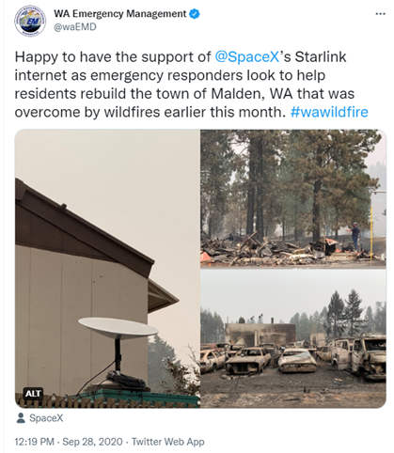


Starlink: A connectivity solution for emergency response activities anywhere in the world
Inherently designed to reduce reliance on ground infrastructure
Ideally suited to service areas of the where connectivity is disrupted, unreliable, or completely unavailable after…
Fires
Flooding
War

Slide 3
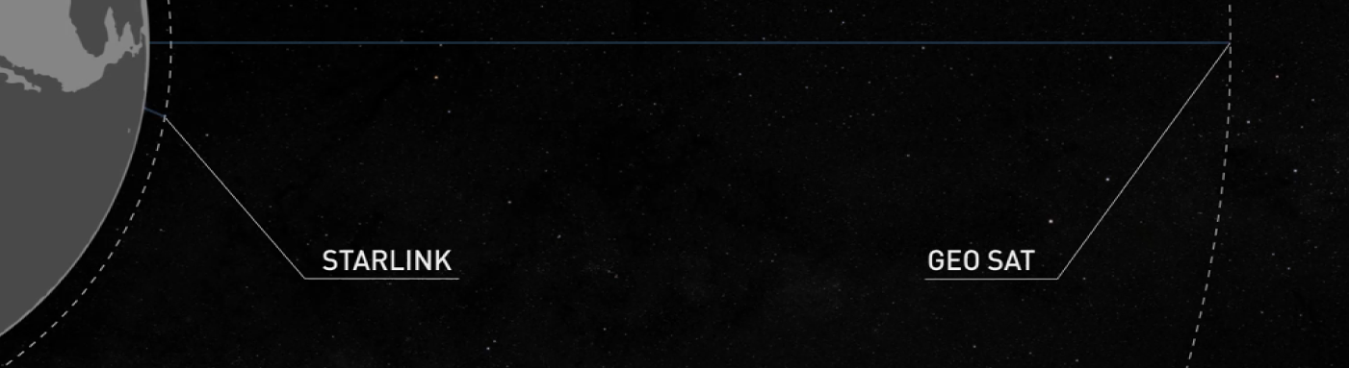
STARLINK: NEXT GENERATION CONNECTIVITY FOR REMOTE AREAS
SpaceX’s Starlink is the world's first satellite constellation operating close to earth to deliver high-speed, low latency internet capable of supporting streaming, online classes, video calls, and more.
Users connect to 150mbps+ download speeds within minutes of unboxing Starlink hardware, which has been designed for rapid deployment and self-installation.
Starlink offers an affordable and fast solution for connectivity in the world’s most remote areas.
Geostationary Orbit
at 35,786 km
STARLINK
TRADITIONAL PROVIDERS
Low Earth Orbit
at 550 km

Slide 4
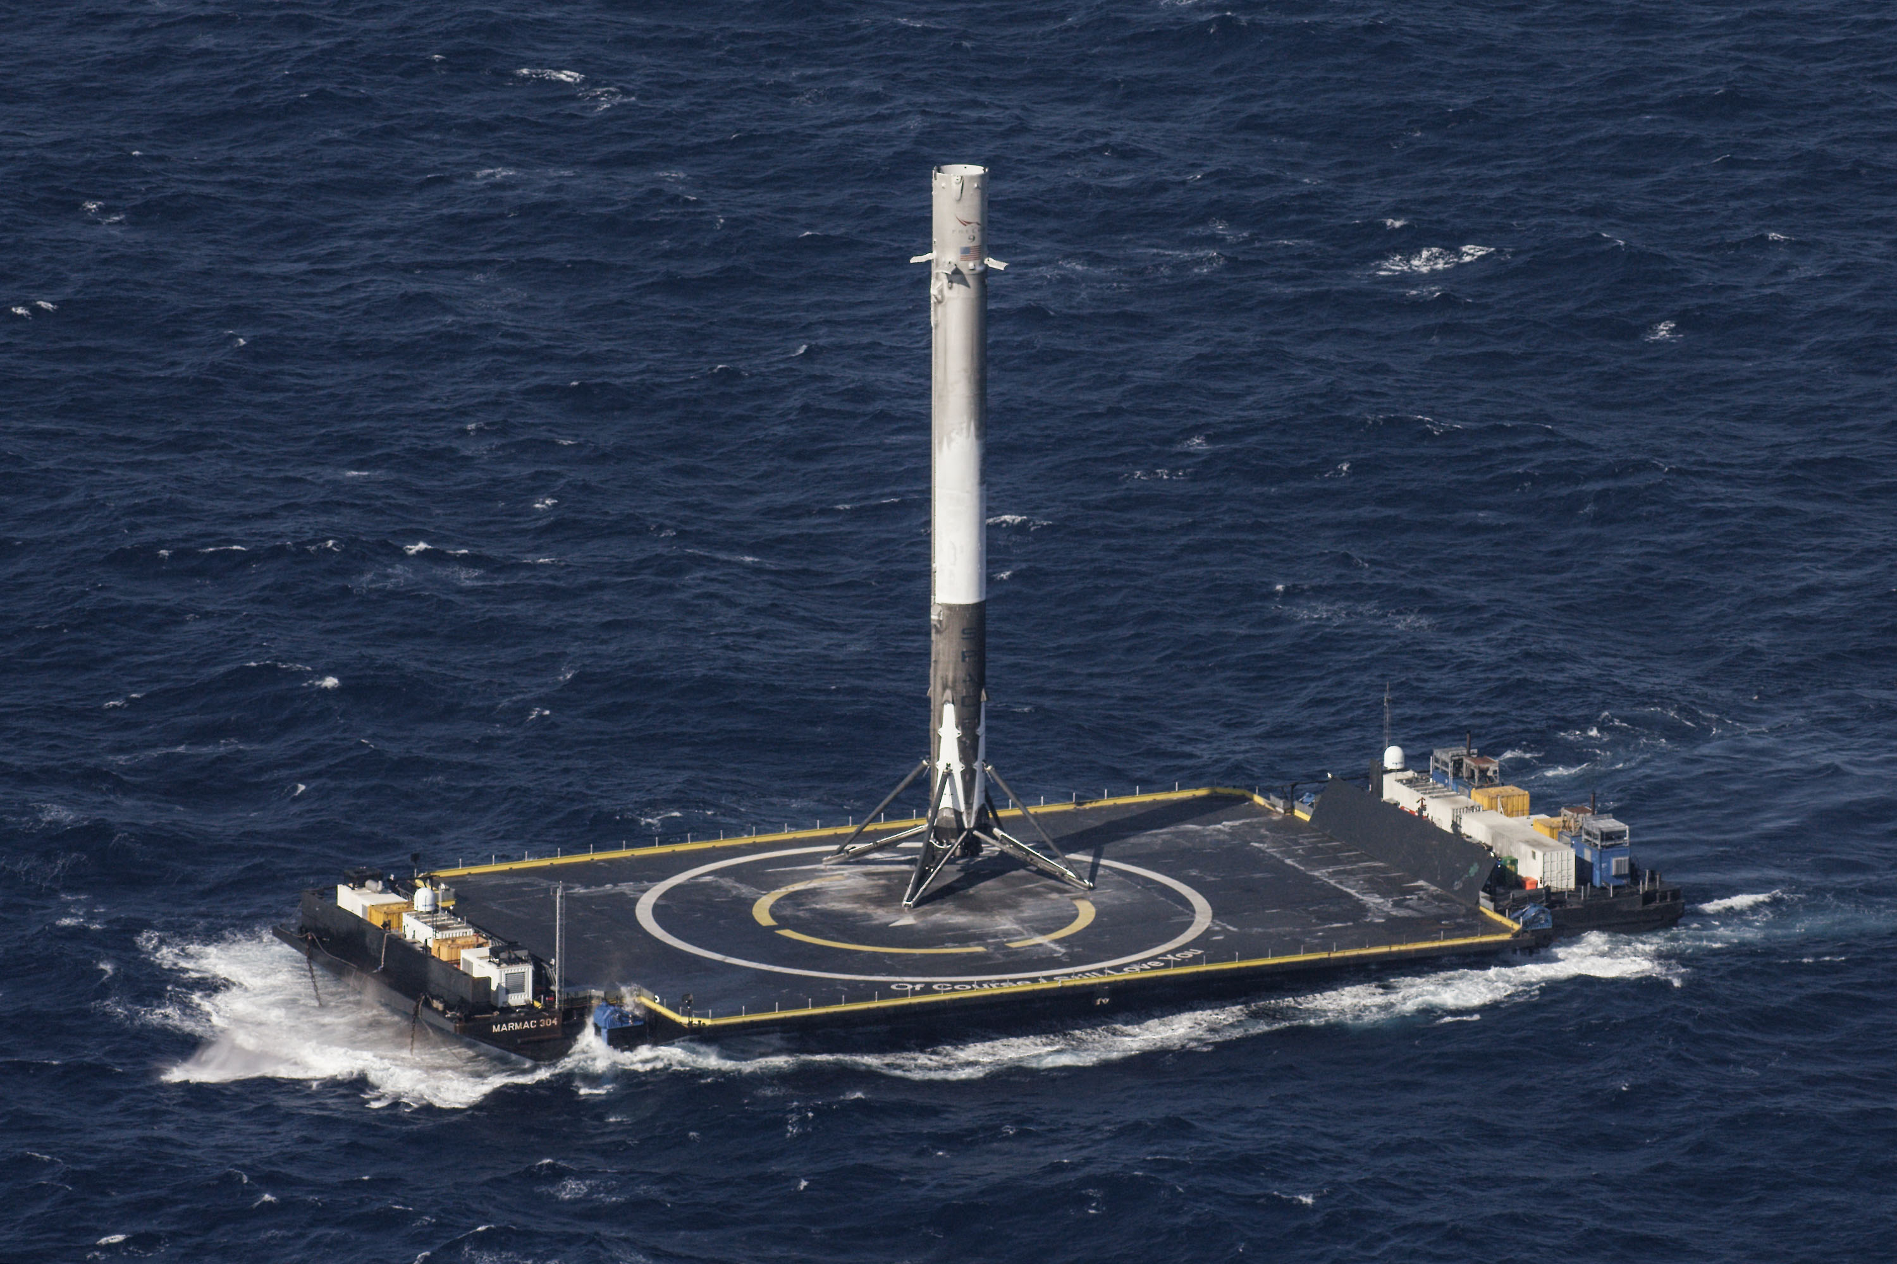
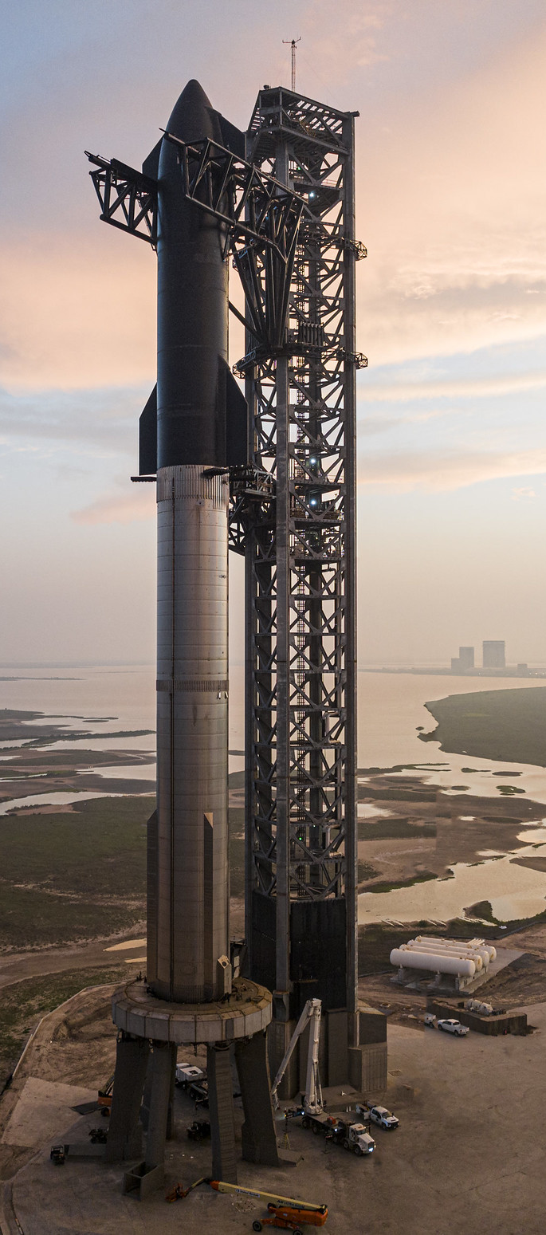

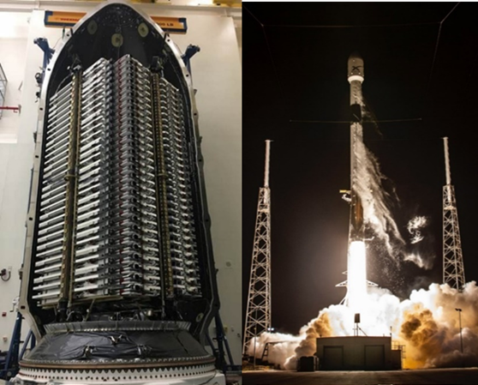
About SpaceX
Founded in 2002 to make humanity interplanetary
Entrusted by the U.S. and other Governments to deliver payloads and astronauts to space
Pioneered rocket reusability
Will return Americans to the Moon for the first time in over 50 years
Starlink service: Activated in the U.S. in October 2020
Providing low latency, high speed connectivity to over 1,000,000 customers
4,000+ satellites launched in the past 4 years
Live in over 65 global markets
Manufacturing over 32,000 Starlink kits (user terminal) and 50 Starlink satellites per week in the U.S.

Slide 5
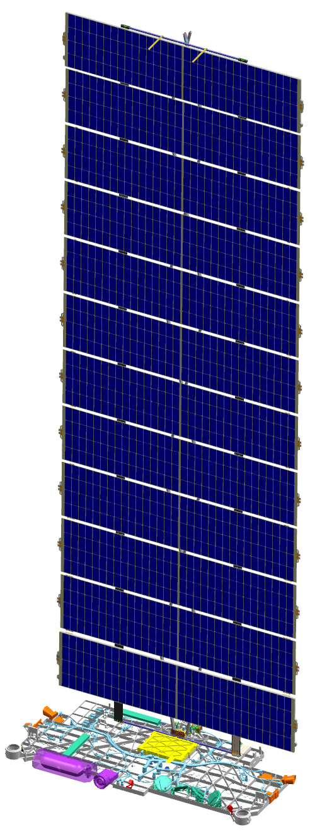





HOW STARLINK WORKS
Starlink Satellite Constellation
4,000+ satellite launched to date
Enables high-throughput, low-latency broadband service to end-users who are not in physical proximity to ground infrastructure (fiber)
Resiliency through path diversity
Get online in a few minutes, with only a power source & a clear view of the sky
100gbps+ Optical Intersatellite Links (ISLs)
10.7 – 12.7GHz Downlink 14.0 – 14.5GHz Uplink
(Ku-band)
17.8 – 19.3GHz Downlink
27.5 – 30.0GHz Uplink (Ka-band)
Datacenter
cross connects
Leased fiber
Internet Content
Internet Point of Presence (PoP) at Data Center
Starlink Gateway Site
Customer Site / Starlink Kit
Residential or Enterprise Backhaul solution
End-to-End Encryption: From Starlink Kit to PoP
Customers may encrypt on top

Slide 6


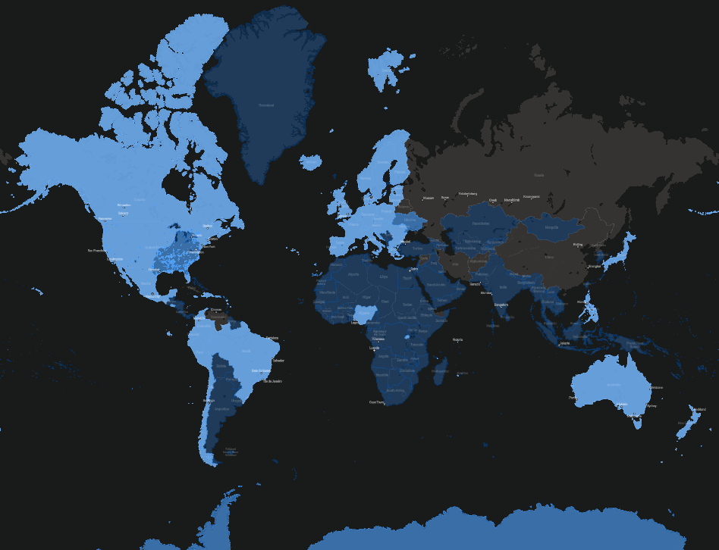

BENEFITS OF STARLINK
Ubiquitous global coverage using dynamic beams
Each satellite has multiple beams, each of which serves a concentrated area on Earth (cell)
Low (<40ms) latency enabled by low orbital altitude
At 550km, Starlink satellites are 65x closer to earth than traditional SATCOM providers
Only requires deployment of small form factor antenna
Designed for easy self-install in minutes (plug & play)
No manual pointing or technical expertise required
Regular software updates ensure older hardware versions remain supported
Network capacity increases with more satellites on orbit
Capable of launching 300+ satellites per month on a SpaceX-built, reusable rocket
New version of Starlink satellite provides 4-10x the capacity of existing version
Fleet management tools for customized planning & usage for all budgets
Self-activation and deployment by customer
Multiple tiers of service plans for fixed, & portable/mobile use
Pausable subscriptions (not billed when not in use)

Slide 7
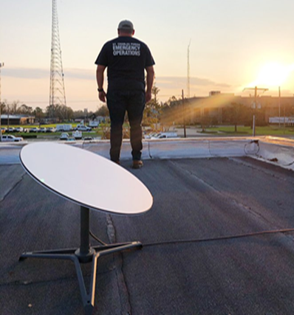
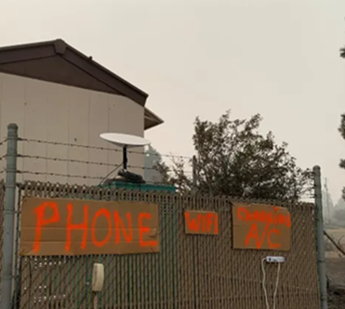

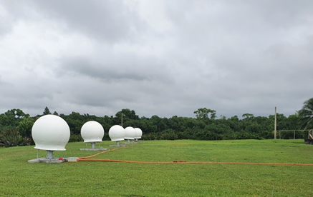
Rapidly deployable to support emergency responders in disaster scenarios
Search and Rescue. After Hurricane Ida, Starlink provided internet service to the Louisiana Emergency Operations team, helping first responders coordinate recovery efforts and upgrade search grids in real time
Emergency Evacuation. Starlink connected families evacuating from wildfires in Washington, enabling them to call loved ones, file insurance claims, and continue schooling while their homes were rebuilt.
Backup to Primary Comms. Established a gateway site in neighboring Fiji within weeks to provide service after a volcanic eruption and tsunami destroyed an undersea internet cable

Slide 8
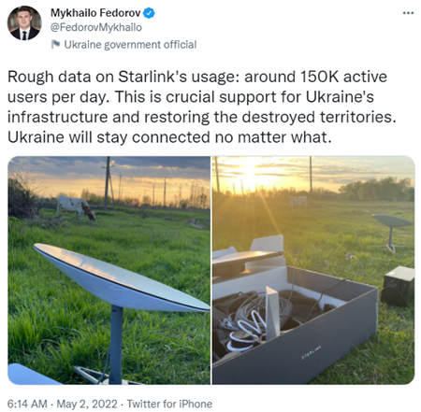
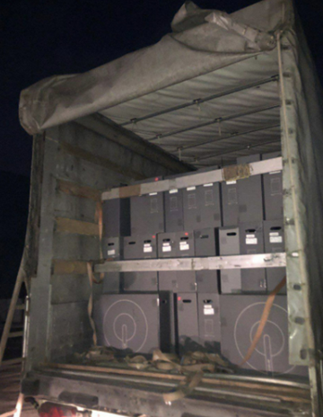
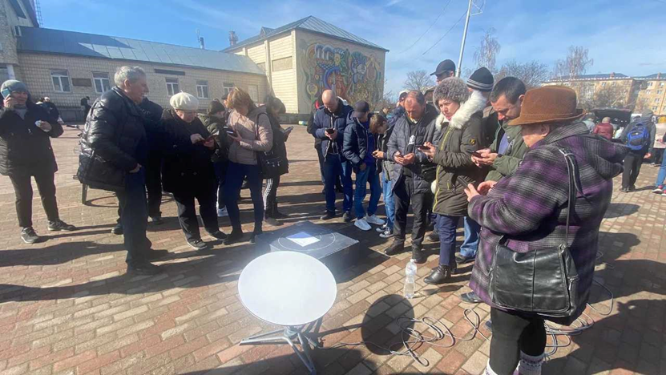
Starlink In Ukraine
48 Hours Later
Russia Invades
Today
0 Kits
400 Kits
20,000+ Kits
Rapid Updates
Reduced the Starlink kit’s peak power consumption so it can be powered from a car cigarette lighter
Activated mobile roaming so the Starlink kit can maintain a signal on a moving vehicle
Mitigated extensive GPS jamming events within hours of impact
Notes:
Opened our eyes military use
Experimenting with US DoD -> Operational use in contested environment
Rapid Transition! Form commercial to wartime use

Slide 9
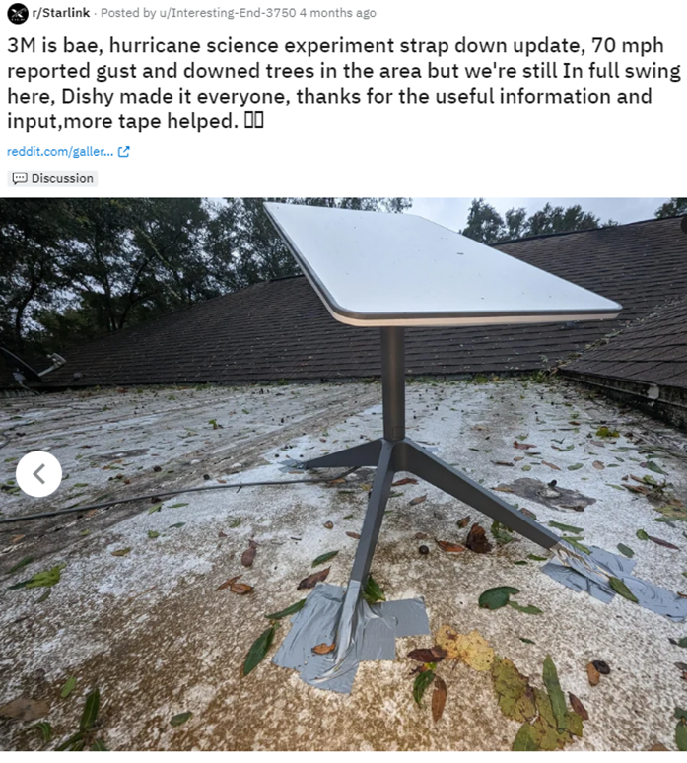
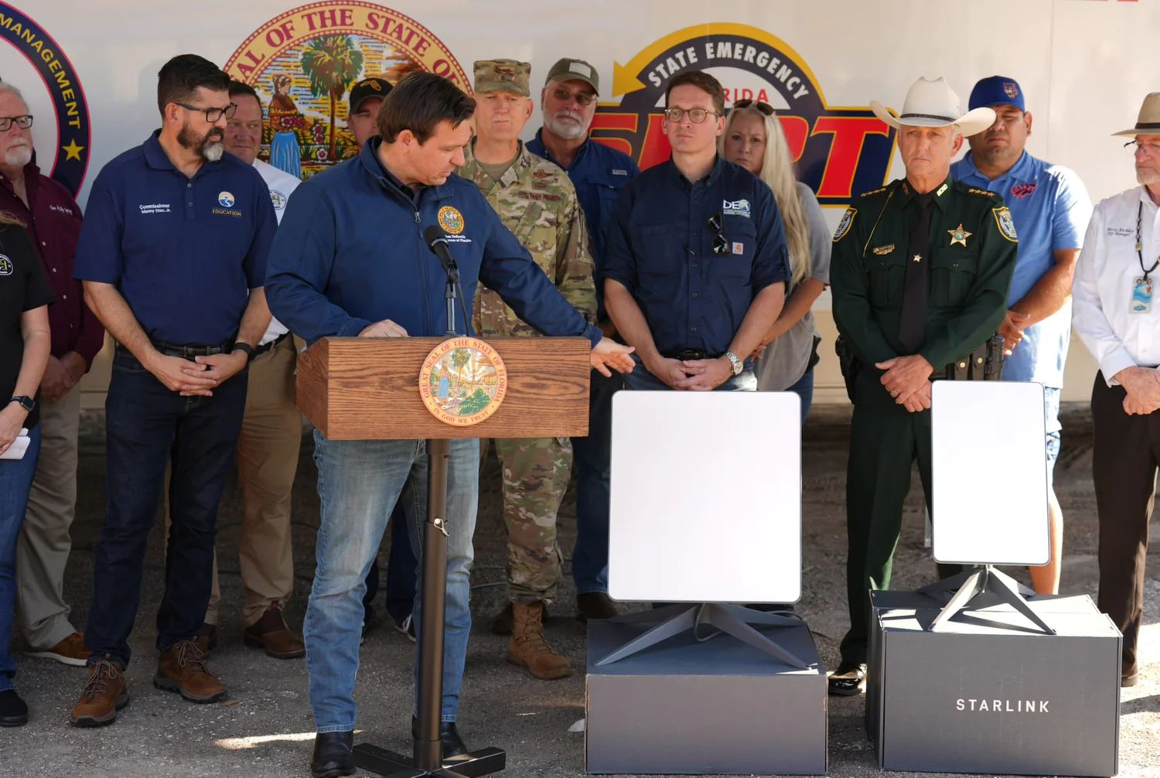

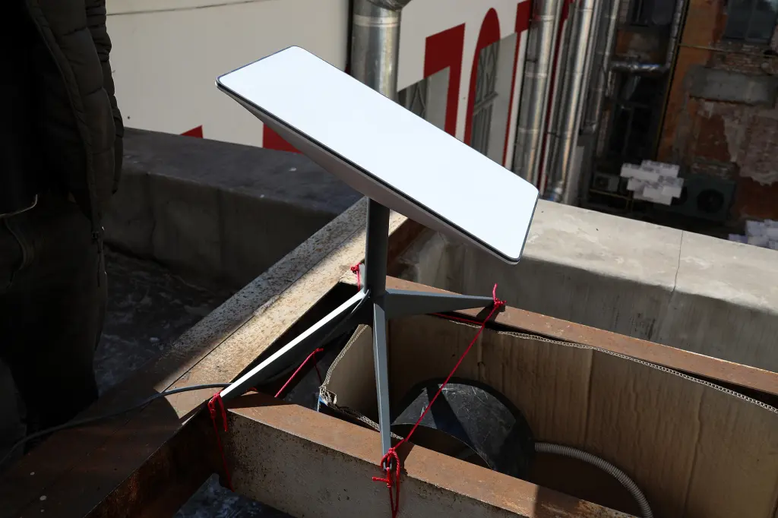
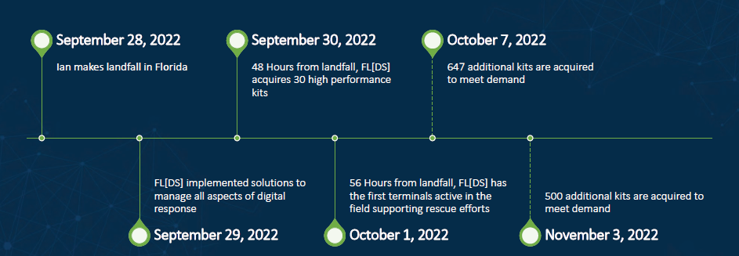
Hurricane Ian Deployment

Slide 10
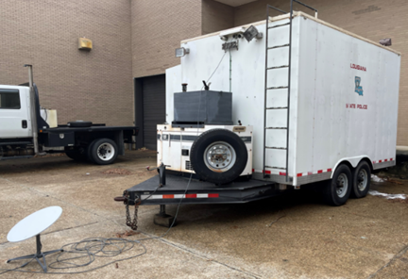

Starlink is designed to support a full suite of video, streaming, and other high bandwidth connectivity demands in extreme environments
Community WiFi. Connectivity for evacuee hubs; locate & connect unaccounted people
Return of Essential Services. Restore functionality of airports, banks, and post offices
Access to Critical Goods. Enables grocery stores, banks, gas stations, and other business to continue operating their point-of-sale (POS) and inventory systems
Health Care Operations. Primary and emergency connectivity to health care facilities; remote monitoring of high-risk, home-bound patients; mobile clinics
School Connectivity. Provide remote learning capabilities during disaster recovery
Law Enforcement. Re-activate traffic lights, provide backup connectivity to correctional facilities

Slide 11

PRODUCT & SERVICE OFFERINGS

Slide 12




HIGH PERFORMANCE KIT
Enables higher speeds, connects to more satellites, and more resilient to extreme environments
Hardware: High Performance or Flat High Performance Kit ($2,500 + $50 shipping + tax)
Size: 22” x 20” (dish); 21 lbs (dish + cables)
Operating Temperature: -22°F to 122°F
Snow Melt Capability: Up to 3 in/hour
Wind Rating (Flat kit): 174 mph+
Standard 150W AC Input power
Separated WiFi & Power Supply
Benefits
Use up to 12 mesh nodes ($130/unit) to extend the Starlink signal
Includes publicly routable IPv4 address
May be bonded by user to increase throughput to 2 or more units
May be configured to provision backhaul for fiber or wireless last mile
Notes:
For Starlink there are really two steps: point the terminal at the sky and plug it in
And the user terminal will automatically gimbal to find the satellites that are passing overhead
The service cost is $99 US Dollars a month which translates to $1 Utopian unicorn and a one time fee of $499 for the user terminal
###
In the traditional Wi-Fi model you sometimes need to go to a store to pick up the user terminal and then wait a few days or a week for a technician.
USD $99/month and $499 (one time fee) for the Starlink kit
SpaceX also designs and manufactures the user terminals at the SpaceX headquarters in California

Slide 13

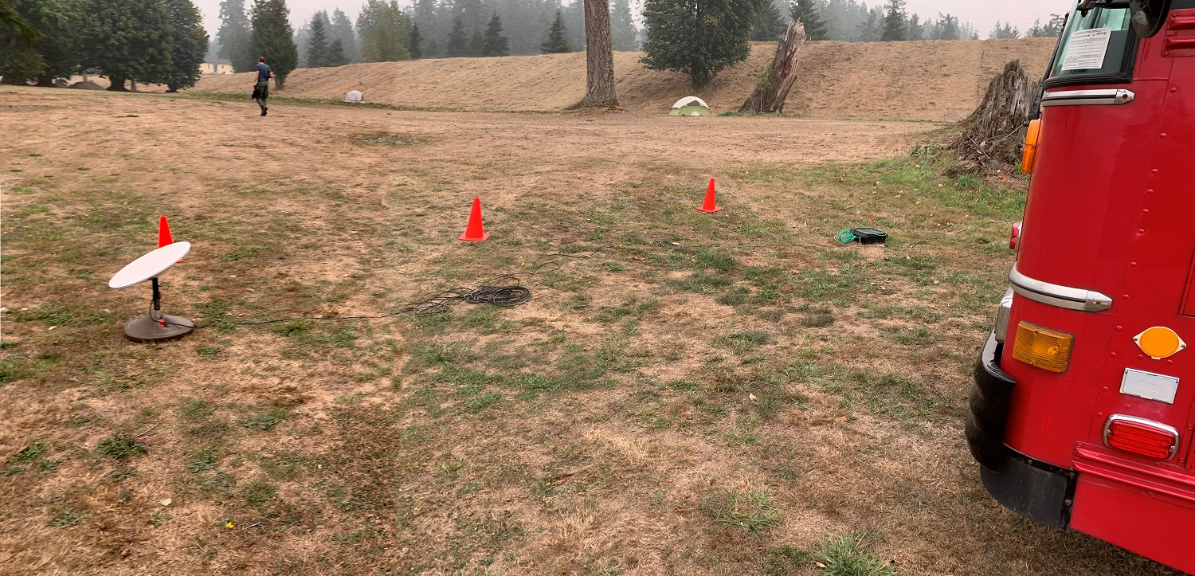
Service Plans with High Network Priority
 | FIXED PRIORITY starlink.com/business | MOBILE PRIORITY (includes Portable use) starlink.com/maritime
Definition | Service at a single address | Service at multiple addresses and/or while in motion
Service Area | Land only (Global) | Land & Sea (Global)
Hardware | Compatible with both High Performance & Flat High Performance Kits ($2,500)
Expected Speeds | 150+ Mbps downlink / 20+ Mbps uplink
Plans After limit is reached, data is deprioritized | 1TB: $250/month 2TB: $500/month 6TB: $1,500/month Opt-in for Additional Data: $0.50/GB | 50GB: $250/month 1TB: $1,000/month 5TB: $5,000/month Opt-in for Additional Data: $2/GB PAUSABLE ON A MONTHLY BASIS
These plans have higher network priority than Best Effort, Residential, Roam
Include public IPv4 address, fleet management tools

Slide 14
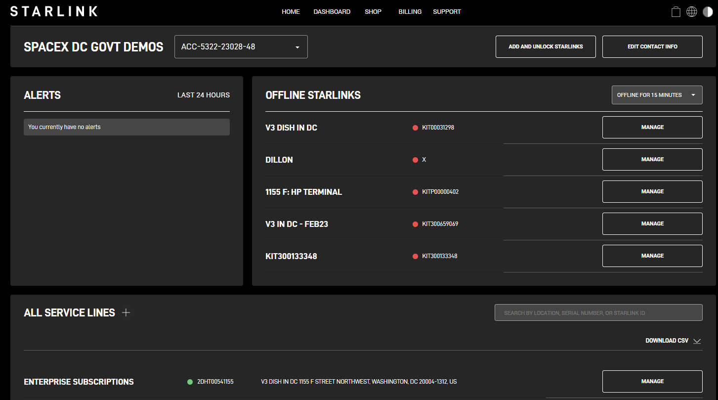
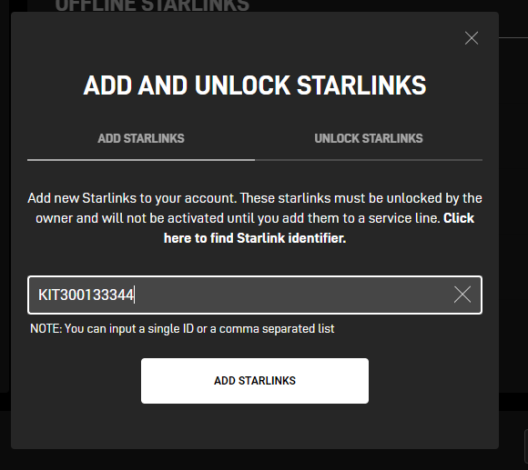
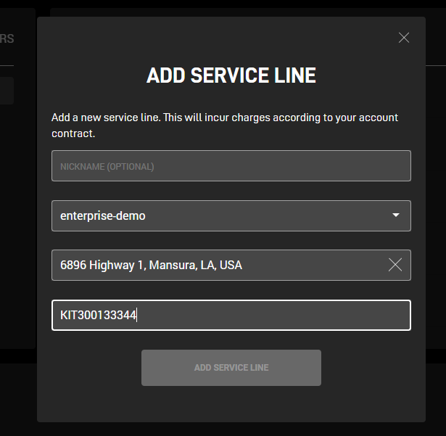
Tools for Customized Planning & Usage
Order Starlink kits*; log into Enterprise Dashboard after delivery
Add Starlink kits to your account
Assign nicknames, subscriptions, and service addresses to your fleet
Pause, cancel, or change subscriptions on a monthly basis–- only receive an invoice for active subscriptions*
Training at fixed location → operational deployment
Activate and change service addresses as needed
*Or pre-pay for a # of monthly service credits consumed over time by your fleet

Slide 15
FAQ
Email us to get the link to our weekly 90-minute
Webinar, which covers:
Technical Overview & Deployment Plans
Starlink for Community Projects
Product & Service Offerings
How to buy Starlink
CONTACT US
General Procurement Inquiries
Candace Lee
Manager
Government Sales
Candace.Lee@spacex.com
Government –
ACP, E-Rate, Tribal Projects
Erica Myers
Senior Manager
Global Government Affairs
Erica.Myers@spacex.com

